Slide 1
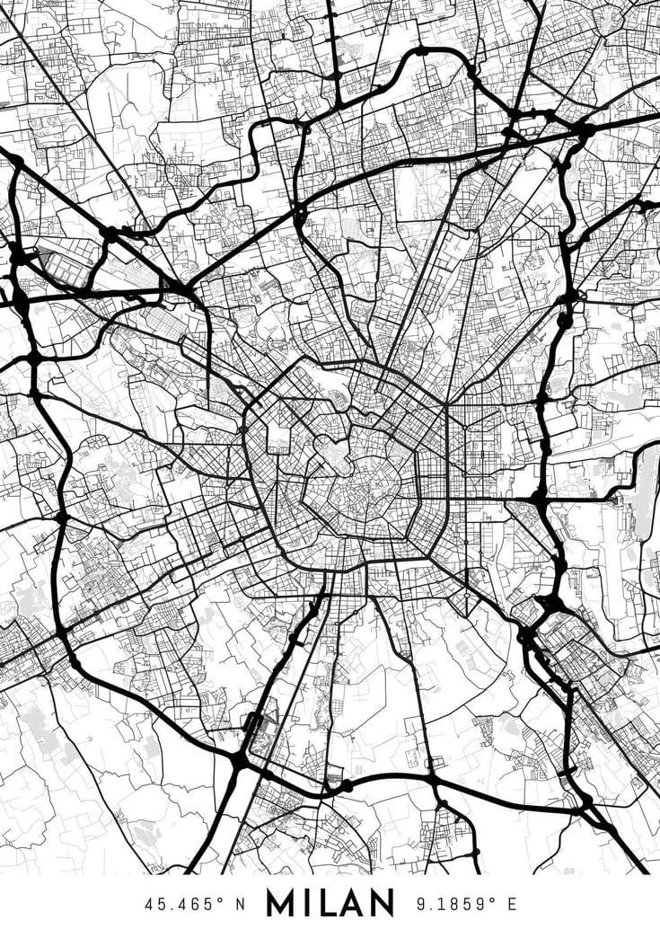
Dynamic EV Charging Locator: Enhancing Navigation Efficiency
CSL2020/Data Structures And Algorithms
Prof. Suchetana Chakraborty
Mentor TA: Garvit Chugh
Team Members: Aditya Pote (B22ME005)
Rohan Gupta (B22MT037)
Rutam Rajhansa (B22ME055)
Explore the dynamic world of electric vehicle (EV) charging infrastructure and discover how a cutting-edge locator can revolutionize your driving experience. Seamlessly navigate to the nearest available charging station, even in the face of road closures and changing conditions.
Notes:
1

Slide 2
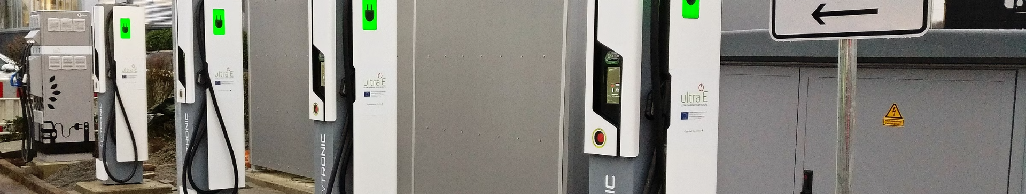


Introduction to Electric Vehicle (EV) Charging Infrastructure
Our solution addresses the challenge of locating the nearest EV charging station.This is crucial as electric vehicles gain popularity, emphasizing the need for accessible charging infrastructure. Our aim is to provide real-time information to EV users, enabling efficient route planning and minimizing downtime.
Notes:
2

Slide 3
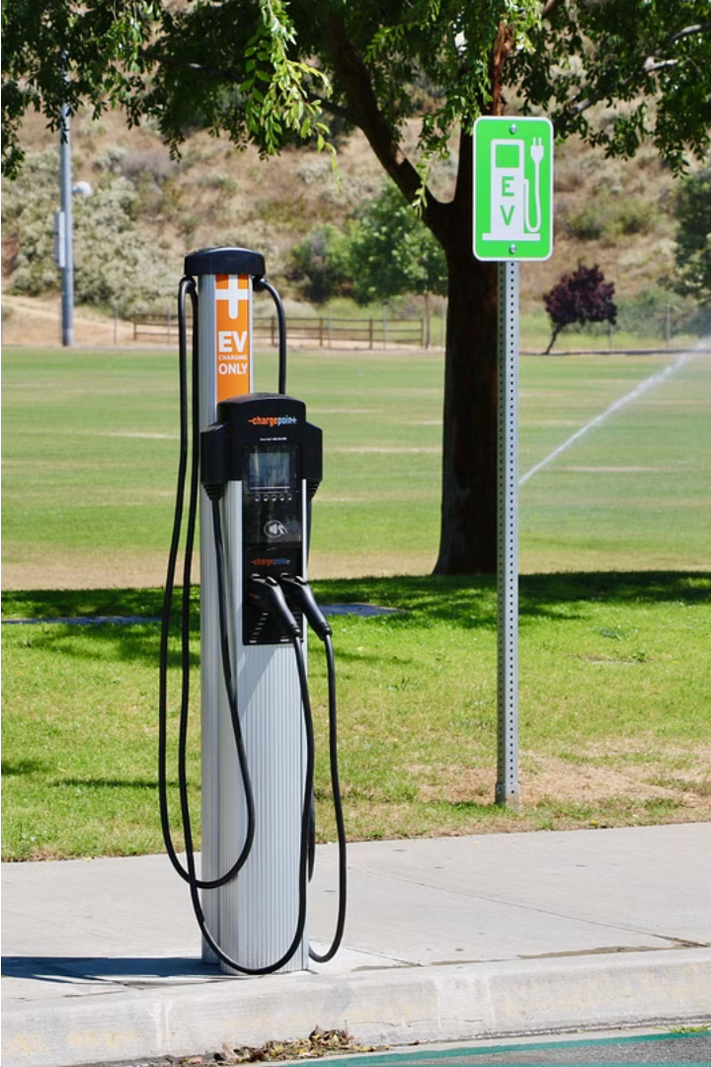
Importance And Relevance
Environmental Sustainability: Supporting electric vehicles contributes to reducing emissions and promoting eco-friendly transportation.
Mobility: Efficient transportation is essential for students, residents and visitors, thus in coming time Transportation is important which should be eco friendly hence enhancing mobility and convenience is important .
Technological Innovation: Addressing EV charging station location aligns with smart transportation solutions and showcases the commitment to technology.
Current Status : -
After research and findings we got to know that there is no particular existing solution but there are some projects which are working on this problem.
we studied a research paper on it :
BiS4EV: A fast routing algorithm considering charging stations and preferences for electric vehicles
Notes:
3

Slide 4
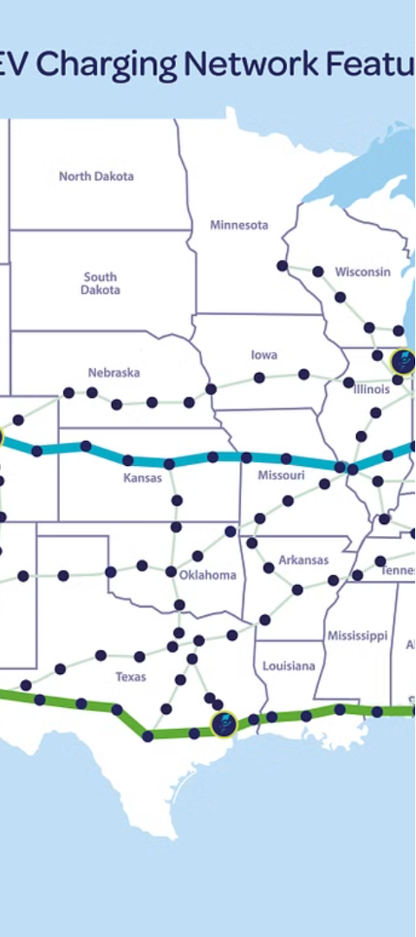
Locating EV Charging Stations
Why it’s a challenging Problem ?
1
Navigating Detours
When roads are closed or traffic is rerouted, it becomes challenging to locate the nearest available EV charging station along the new route.
2
Calculating Optimal Routes
Determining the shortest path to reach an EV charging station is crucial, especially when time and range are limited.
3
Dynamic Road Conditions
Real-time updates on road closures, construction, and traffic congestion are essential for planning an efficient EV charging stop.
Notes:
4

Slide 5
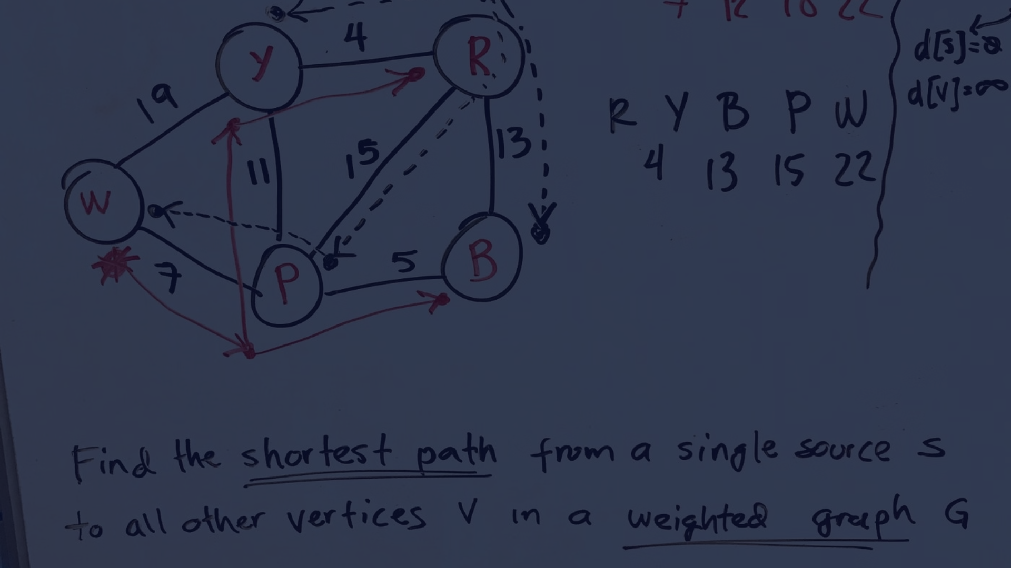




Our Idea and Implementations
We need to Optimised route planning so we go through Dijkstra's algorithm which guarantees in finding the shortest paths from the source to all other vertices in the graph
But for real world shortest path is not only the problem Therefore in Route calculating we incorrporate some real life conditions which ensures optimal route planning.
The conditions are : -
Handling of Road Closures
Traffic Conditions
The implementation includes features to handle road closures and traffic conditions dynamically, providing more realistic and useful route recommendations for users.
Implementation Procedure : -
Graph Creation
Graph Representation
Dijkstra's Algorithm
Consideration of Road Closure
Updating Traffic Conditions
→Github link for our code
Notes:
5

Slide 6
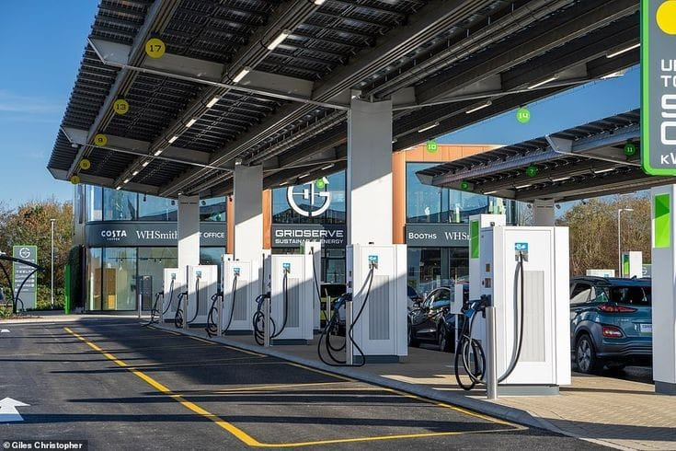


Comparitive Analysis
We tried to implement it using DFS and then Dijkstra. During DFS execution, we were getting wrong output for some test cases. then after research we got to know that :-
Might find a path that is shorter than the current shortest path, but it doesn't ensure that it explores all possible paths to find the absolute shortest one
DFS doesn't consider the weights of the edges
DFS can potentially get stuck in infinite loops, etc.
So we stick with dijkstra algorithm to get shortest distance.
The Running time comparison between the researched code and our code is : -
Our code running time : -
Existing solution running time :-
Notes:
3

Slide 7

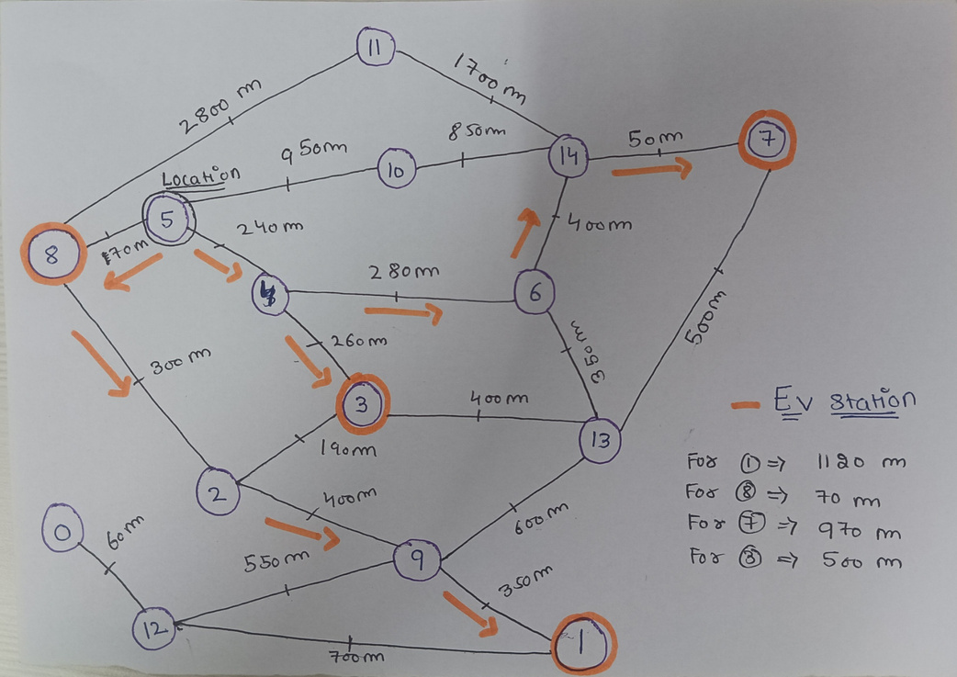
EXAMPLE USAGE :
We have taken a demo example graph of IIT JODHPUR
In this example our location is at 5 as you can see in the graph sideway. EV stations are present at orange marked positions { 7 , 3 , 8 , 1} .lets say we have to find a charging station near 5 and the charging station is 8. There are many ways to go on charging station 8 but the shortest distance is 70 m and the road is not closed therefore path followed should be 5 -> 8
Case 1 : - all roads are open
Notes:
6

Slide 8
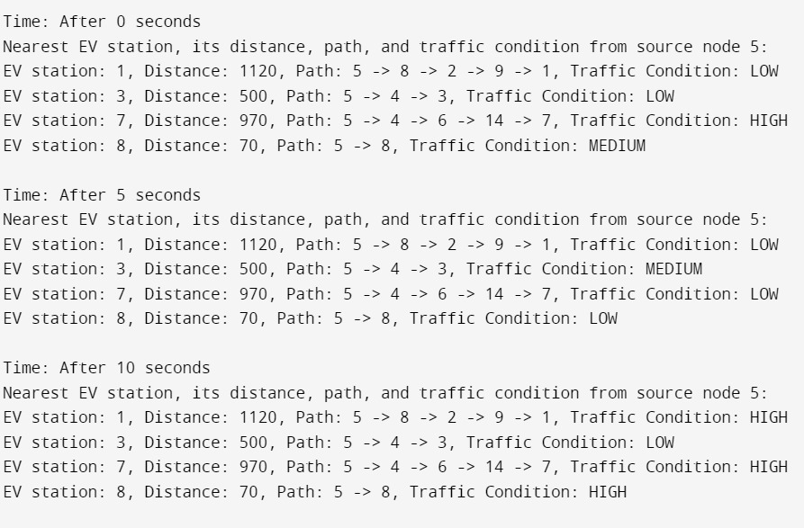

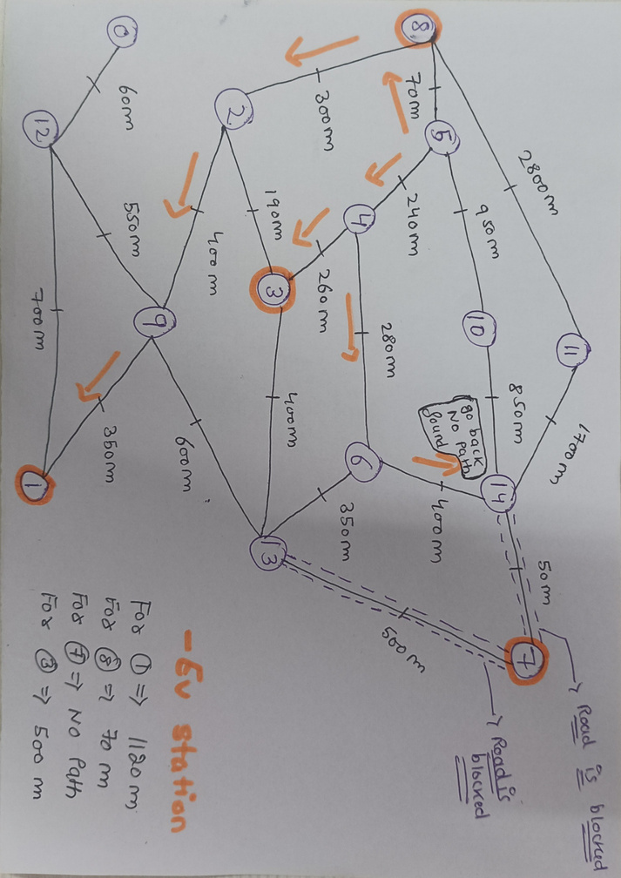
Results --->
Case -1
In case 2 our location is at 5 as you can see in the graph sideway. EV stations are present at orange marked positions { 7 , 3 , 8 , 1} where road is closed from 7 ->13 and
7-> 14 therefore for station no 7 there is no path hence output should be no path found .
--->
Case -2
Notes:
7

Slide 9
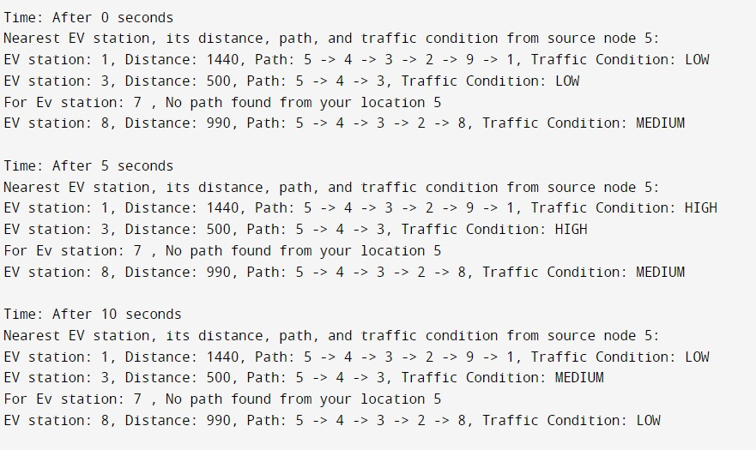


Results Case 2 ----->
Costs
Computational Cost:
The main computational cost comes from running Dijkstra's algorithm, which has a time complexity of O(E + V log V) for a graph represented as an adjacency list, where V is the number of vertices and E is the number of edges.
In our code, the graph is represented using an adjacency list, so the Dijkstra's algorithm's time complexity is O(V^2 ), where E is the number of edges and V is the number of vertices.
Additionally, updating traffic conditions also has a cost, but it's relatively low compared to Dijkstra's algorithm
.
Memory Cost:
Memory is allocated for storing the graph, adjacency lists, nodes, and other data structures. The space complexity is O(V + E), where V is the number of vertices and E is the number of edges.
Notes:
8

Slide 10


Conclusion and Contributions
Innovation Summary:
Our project offers a dynamic solution for electric vehicle drivers by providing real-time navigation guidance to the nearest charging stations while considering traffic conditions and road closures. By integrating these features, we enhance navigation efficiency and promote the adoption of electric vehicles, contributing to a more sustainable transportation ecosystem.
Rutam's Contribution:
Integrated real-time traffic data, enhancing functionality.
Developed algorithms for predicting traffic patterns.
Optimized code performance and memory management.
Ensured clear documentation and code readability.
Aditya's Contribution:
Explored graph data structures and implemented a suitable representation.
Developed functions for road closures and traffic conditions.
Assisted in code optimization and memory efficiency.
Provided clear documentation for implemented functionalities.
Rohan's Contribution:
Implemented Dijkstra's algorithm for shortest paths.
Developed functions considering traffic conditions and road closures.
Assisted in debugging and troubleshooting.
Provided insights into algorithm optimization and code structure.
Scope of Future Extension:
User Preferences: Adding functionality to allow users to customize route preferences based on factors like charging station types, preferred road types, or scenic routes.
Integration with EV Charging Networks: Integrating with EV charging networks' APIs to provide real-time availability and status of charging stations.
Mobile Application Development: Developing a mobile application for easy access and navigation, providing users with a seamless experience.
Project Summary:
User Preferences: Adding functionality to allow users to customize route preferences based on factors like charging station types, preferred road types, or scenic routes.
Integration with EV Charging Networks: Integrating with EV charging networks' APIs to provide real-time availability and status of charging stations.
Mobile Application Development: Developing a mobile application for easy access and navigation, providing users with a seamless experience.
References:
Research Papers - https://sciencedirect.com/science/article/pii/S0952197621002268
Thanks !!
Notes:
9

